Slide 1
EPAM Cloud&DevOps Fundamentals Course 2022
Mykhailo Pryshchepnyi
Dnipro
Feb 2023

Slide 2
About Project
The project demonstrates the CI\CD process that is relevant and commonly used in the current time for software development and implementation.
It is important because it helps organizations rapidly produce and deliver high-quality software products and services, improving their overall efficiency, reliability, and security. The process automates the entire software development lifecycle, from code creation to deployment.
Additionally, it helps organizations to identify and resolve issues quickly, reducing downtime and increasing overall system stability.
The project uses next tools and services:
GIT and Github – version control system for storage and shared usage app versions and configuration files
AWS Cloud
Jenkins
Terraform
Ansible
Docker and Dockerhub
Slack integration

Slide 3
Task Description
Minimum: - host with git (Linux, MacO5, Windows) [can be on a virtual machine]); - as a semantic part, you can use an HTML page with content of your choice. - cloud repository (GitHub, GitLab, GitBucket), to where you will make commits/pushes; - CI / CD framework (Jenkins) it can be with a “white” IP (from the provider or, better, in AWS) or “gray” (behind the home router, which also has a “gray” IP [NAT]). In the case of gray, you will not be able to use (without additional tools) GitHub Webhook, i.e. you will use other options from lectures. Thus the main purpose of jenkins is to pull out your updated project from a github repo and compile it (build), and then place it in the artifact repository (delivery) or deploy it to the target server (deploy); - Configuration Management Tool (Ansible) - can be used to raise the machines and the initial configuration of the environment for your project; - It is necessary for the jenkins master to redirect jobs to its nodes (slaves). In the case of a web page, this step can be omitted, so the page could be deployed directly to the target server. - docker and containerization can be used in the following way - launch jenkins and its nodes in containers and the target server -- also in a Docker container.
Whatever you do is good anyway. Especially for those who have just started learning DevOps engineering. When demonstrating your project, make minimal changes to the project code, make a commit, push to update the cloud repository (GitHub, GitLab, GitBucket) and let Jenkins handle the changes. It is desirable that the new project build has a visual representation..
By middle / maximum: Middle+ level provides for the implementation of the task in accordance with the above, however, a GitHub prototype of a medium/large Java project (for example, PetClinic) using maven (apt, gradle), testing and deployment can be chosen as the basis. It is also possible to implement a Python project based on an existing GitHub repository.

Slide 4
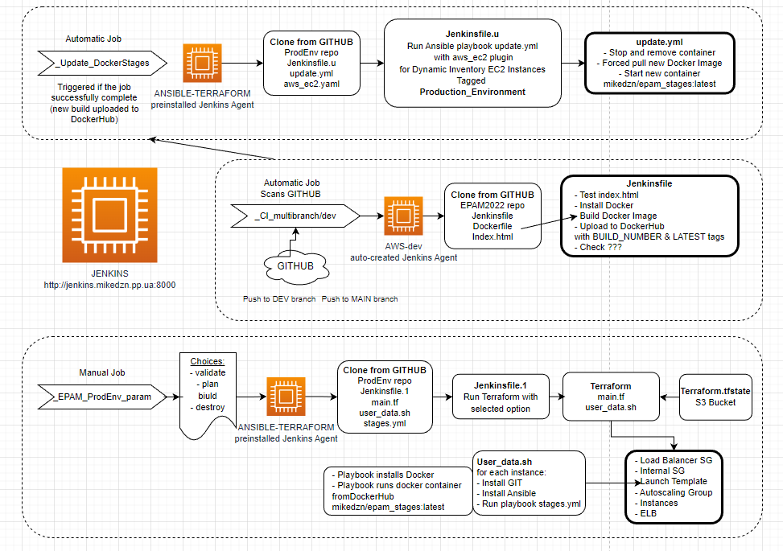
Design
SCEMA
Why were selected specific tools

Slide 5
Implementation
Some stages
Started from …. Усложнение добавление
5. Tasks - breaking down your general task into smaller parts (which are easier to solve). 6. Design (justification why) (Selection of the technology stack that will be used in the implementation of the project) 7. Implementation (if there is testing - excellent) (Project implementation sequence, challenges, achievements, main results) 8. Demonstration (show how your project works in real life) 9. Conclusions (What is done, what I would like to improve and ways to improve)
10. To the question of the minimum / maximum functionality of the project (final task).

Slide 6
DEMO / Conclusions
(What is done, what I would like to improve and ways to improve)

Slide 7
Questions

